Slide 2
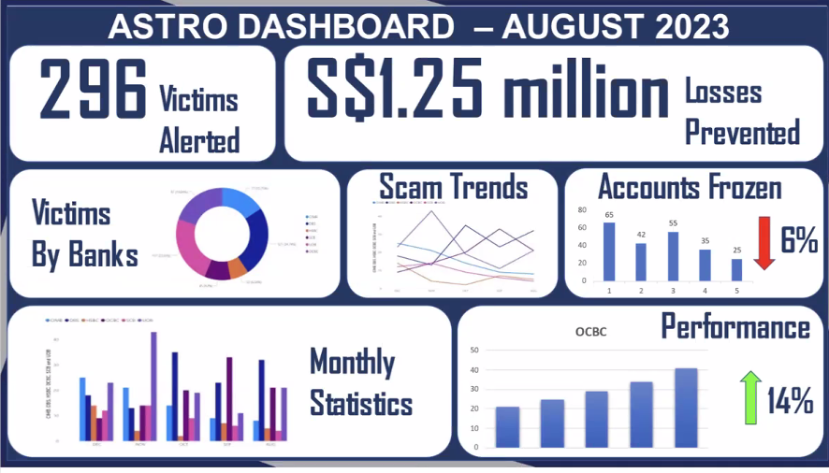
ASC dashboard
Currently in excel in sdrive (ASC to port to MySQL)
8th dashboard is phishpulse

Slide 3
Mysql database login
IP Address: 119.74.24.181
Port: 3306
User: htx
Password: Police123456
Database: astro
SSL: DISABLED

Slide 4
Phishpulse

Slide 5
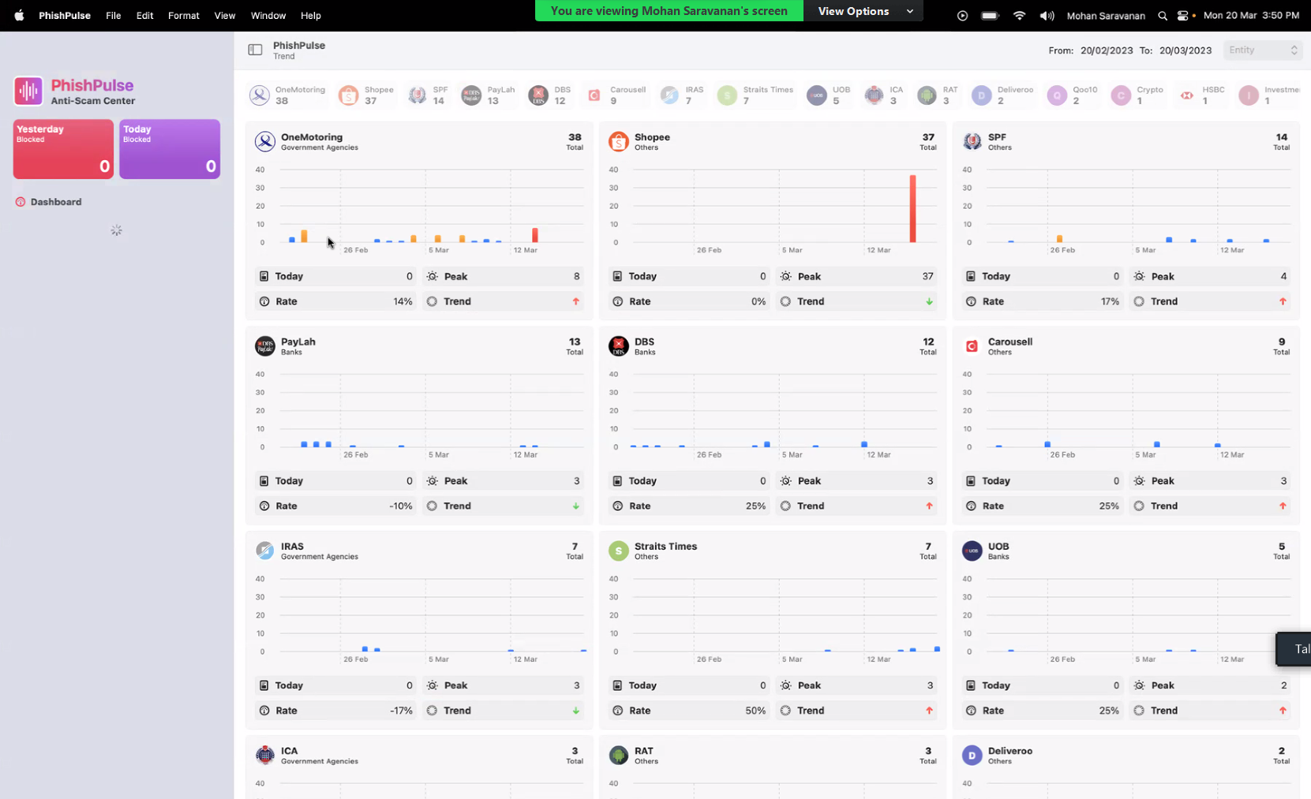
Past 30 days record.
Total number of websites
All stored in mysql
Rate = past certain threshold (e.g. how many days out of 30 days past threshold of 8, e.g. cumulative of past 30 days)
Trend: pass values into linear regression model

Slide 6
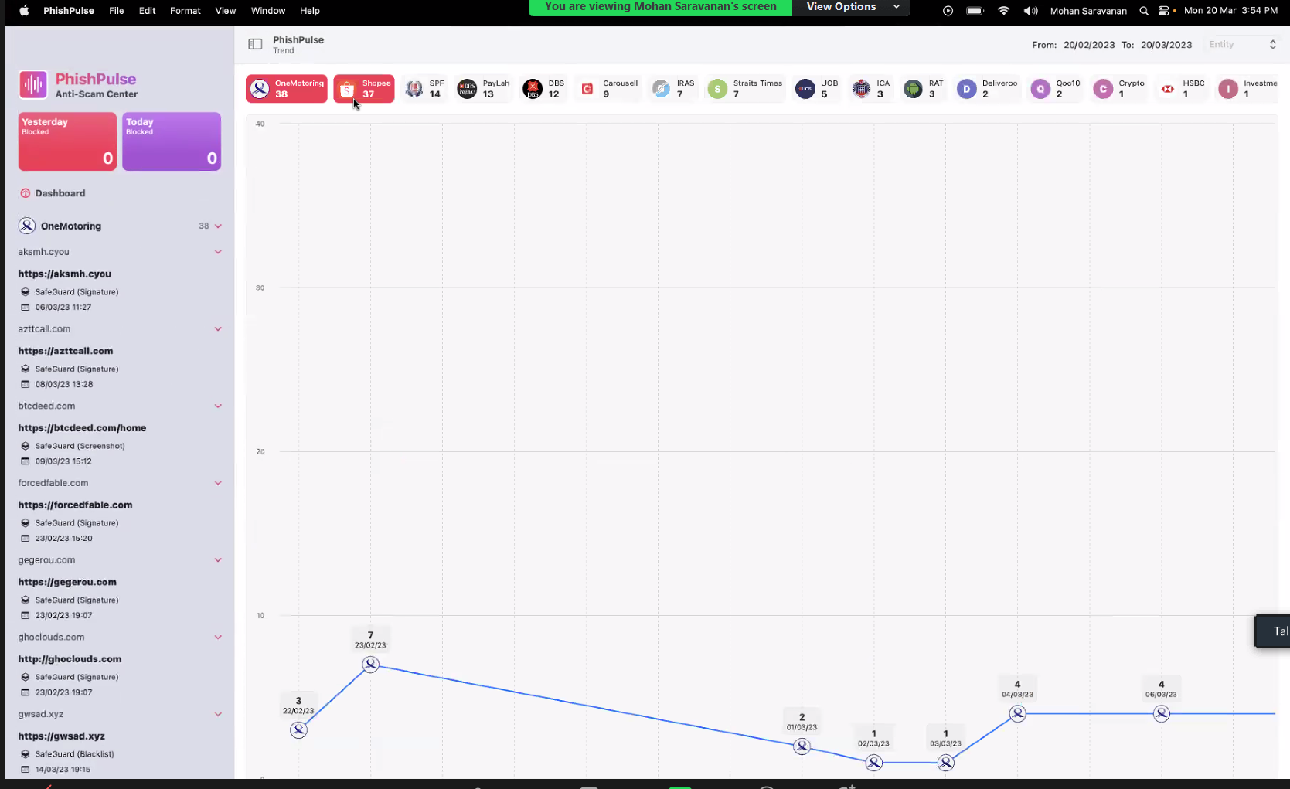

Slide 7
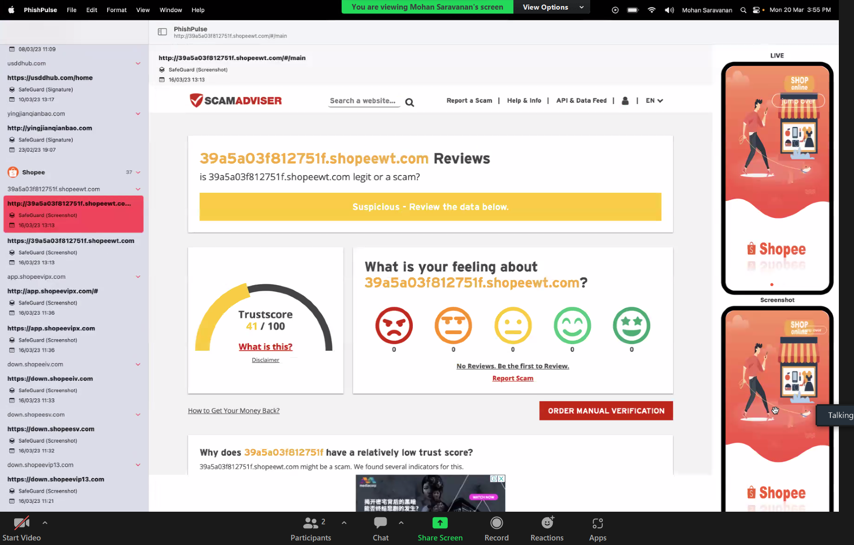
https://api-safeguard.beta.gov.sg/screenshot?api_key=ec16e2d0-1938-49d0-bb0f-a480bc2e8ceb&url_md5=4e332d51fa0c8b94a6b7a9160e10283f

